Slide 1

Software

Slide 2
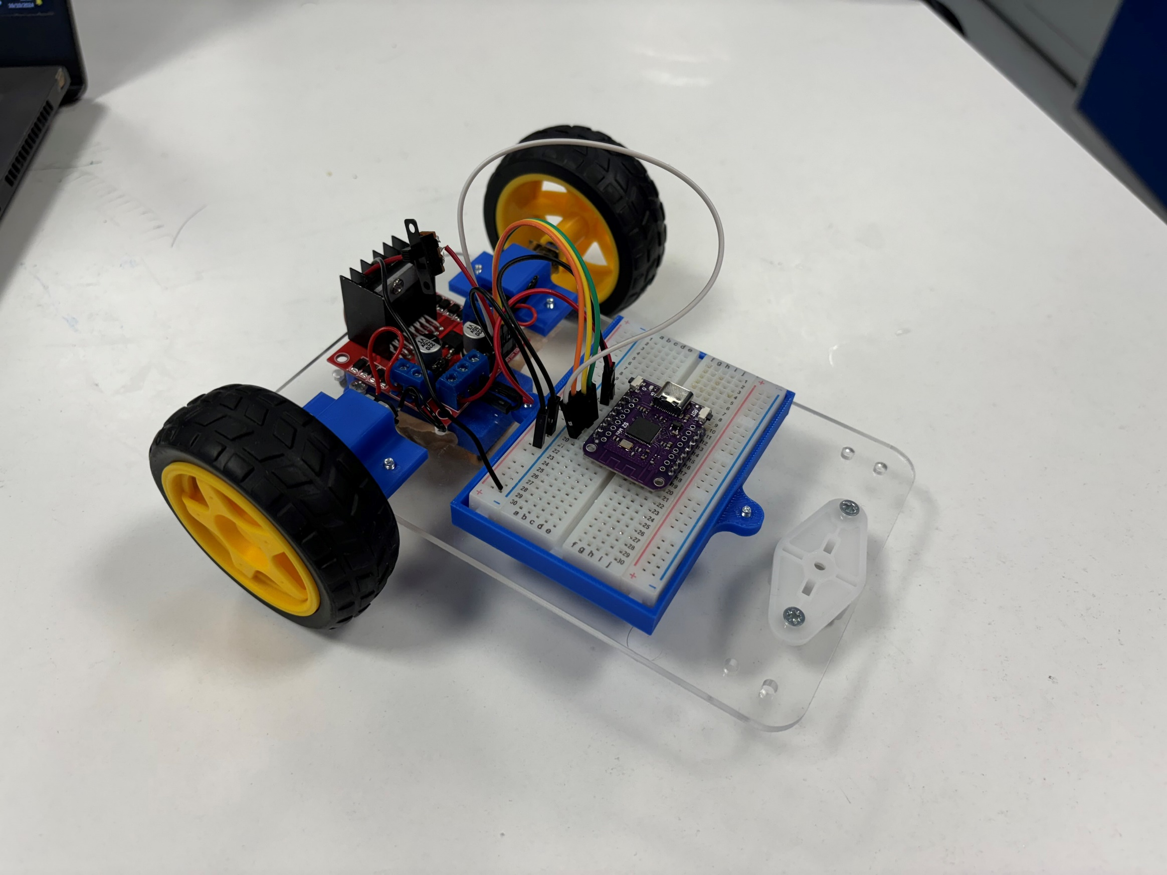
Goals
Introduction to Arduino
Basics of programming
Programming the 101 board
Finish the RC Car 🎉

Slide 3

Programming Microcontrollers
What is a microcontroller?
A small computer with at least one processor, memory and programmable IO.
Arduino IDE
Micro-Python
AVR-GCC + C
…

Slide 4


Arduino
Open-source electronics platform
Targets microcontrollers

Slide 5
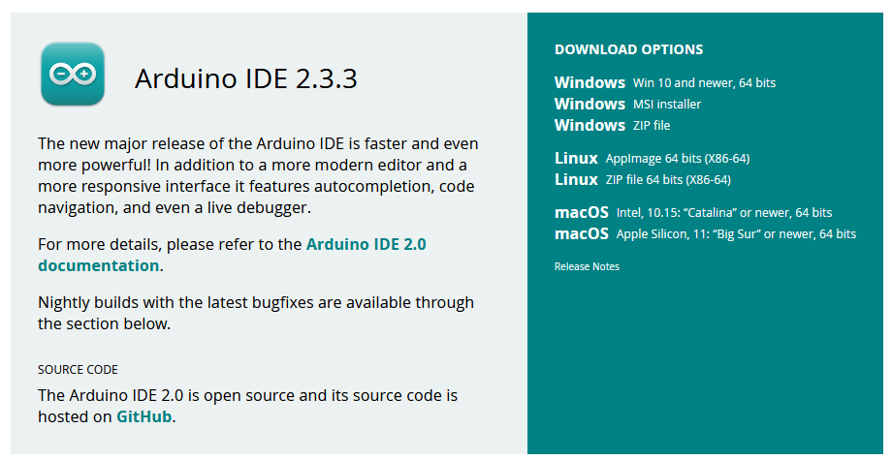
Arduino IDE Setup
https://www.arduino.cc/en/software

Slide 6
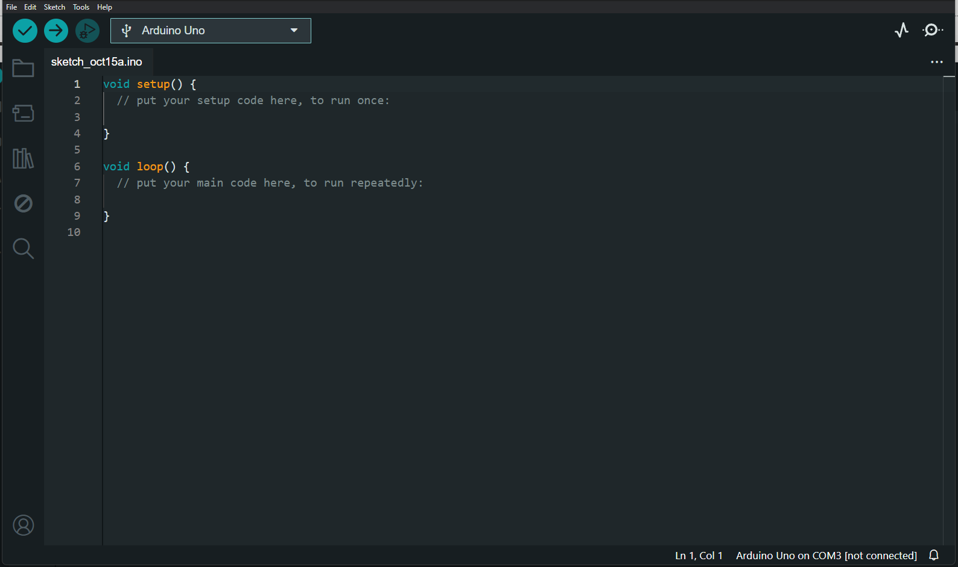

Slide 7
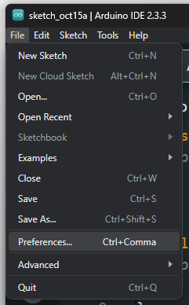
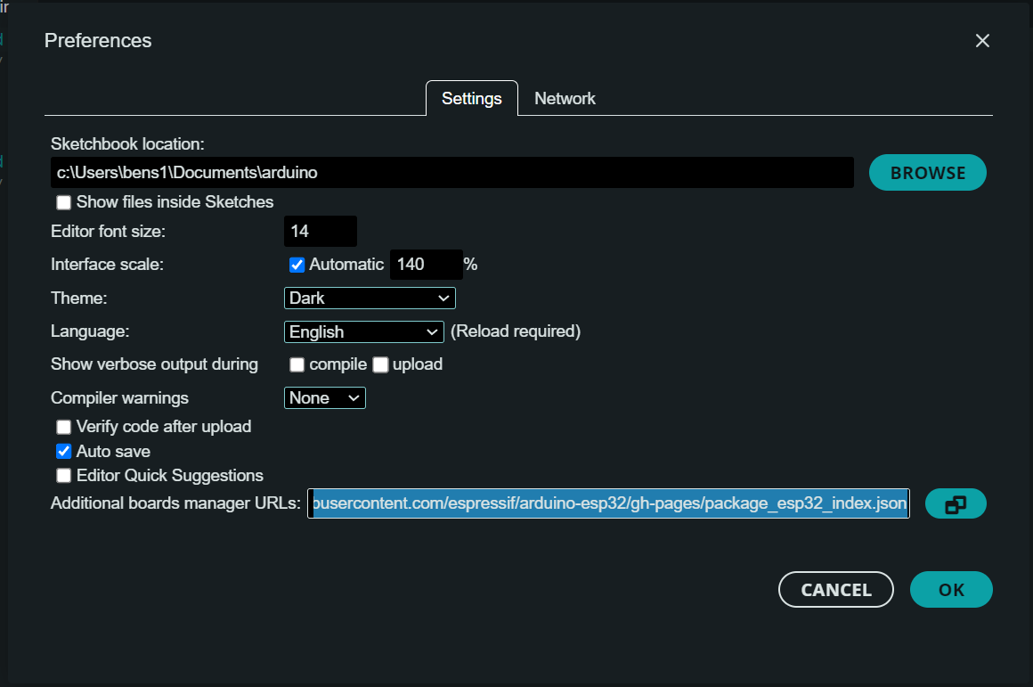
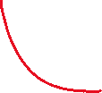

Arduino ESP32
https://raw.githubusercontent.com/espressif/arduino-esp32/gh-pages/package_esp32_index.json

Slide 8
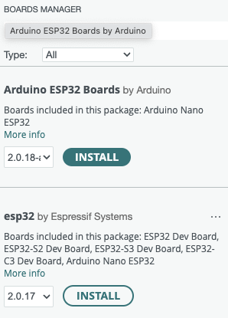
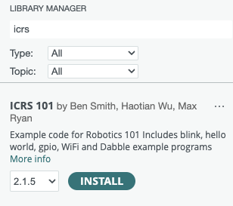

Add ESP32 Board and ICRS 101 Library

Slide 9
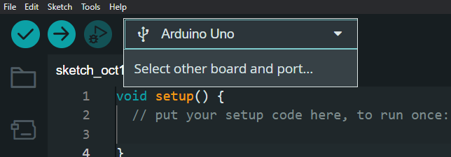
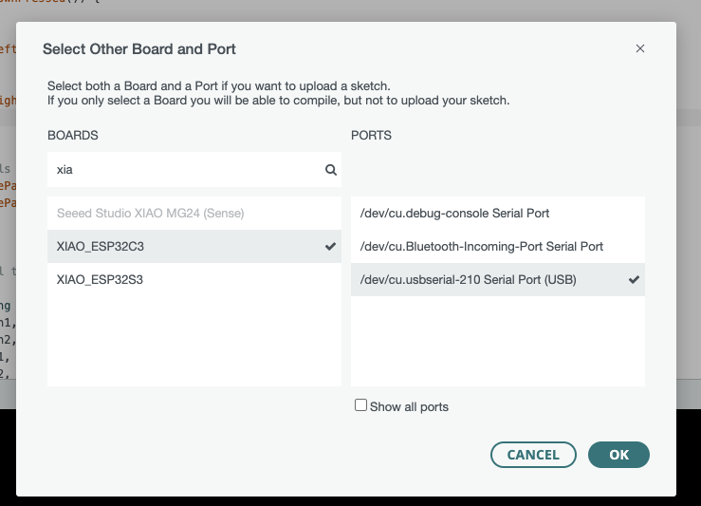
will “COM4” (or some other number on windows)

Slide 10
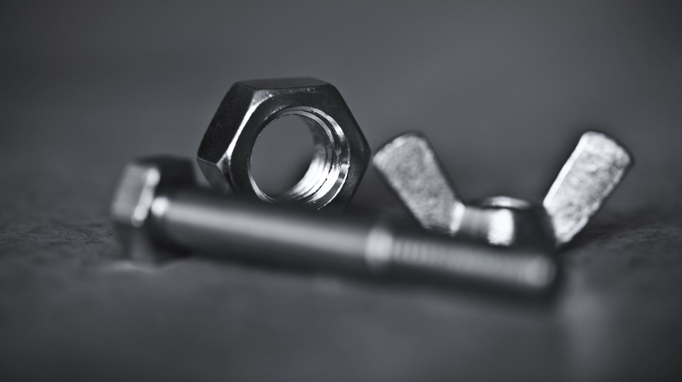
Hardware Recap

Slide 11
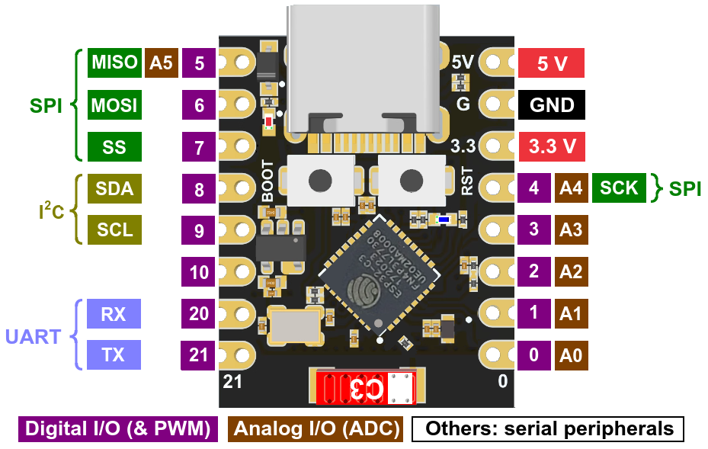
ESP32

Slide 12
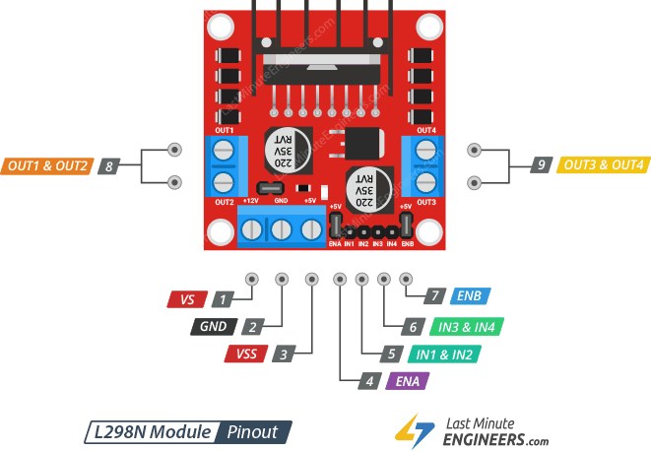
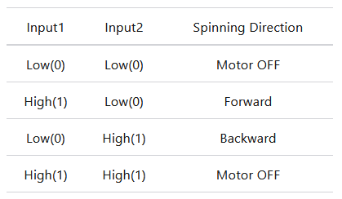
Motor Driver
Motor pin | Microcontroller pin
Input1 | 4
Input2 | 3
Input3 | 2
Input4 | 1

Slide 13

Coding Time

Slide 14
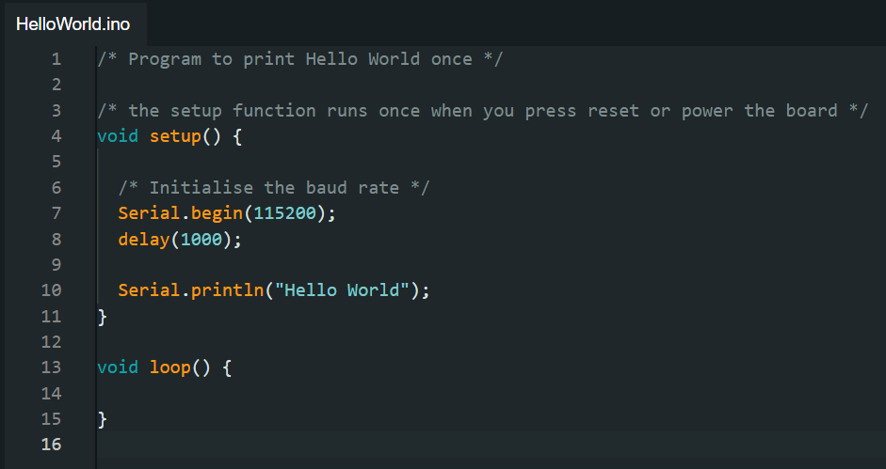
Serial Print ("Hello World")

Slide 15
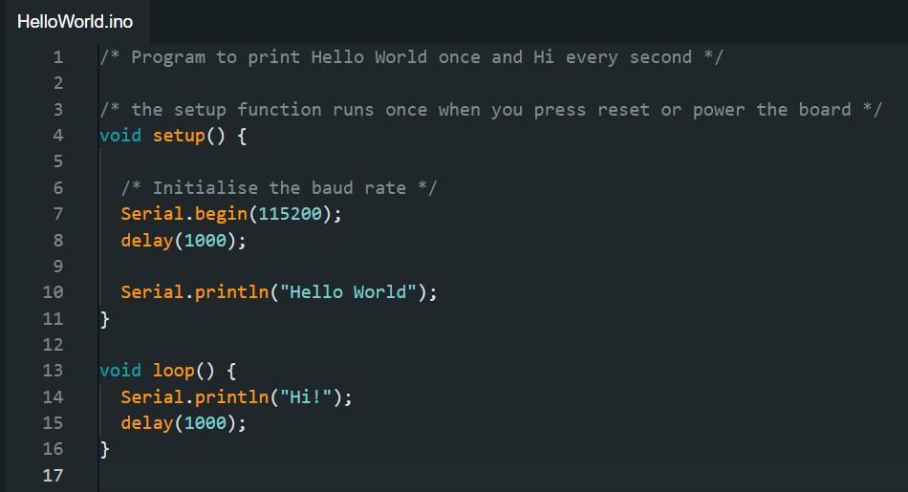
Serial Print ("Hello World")

Slide 16
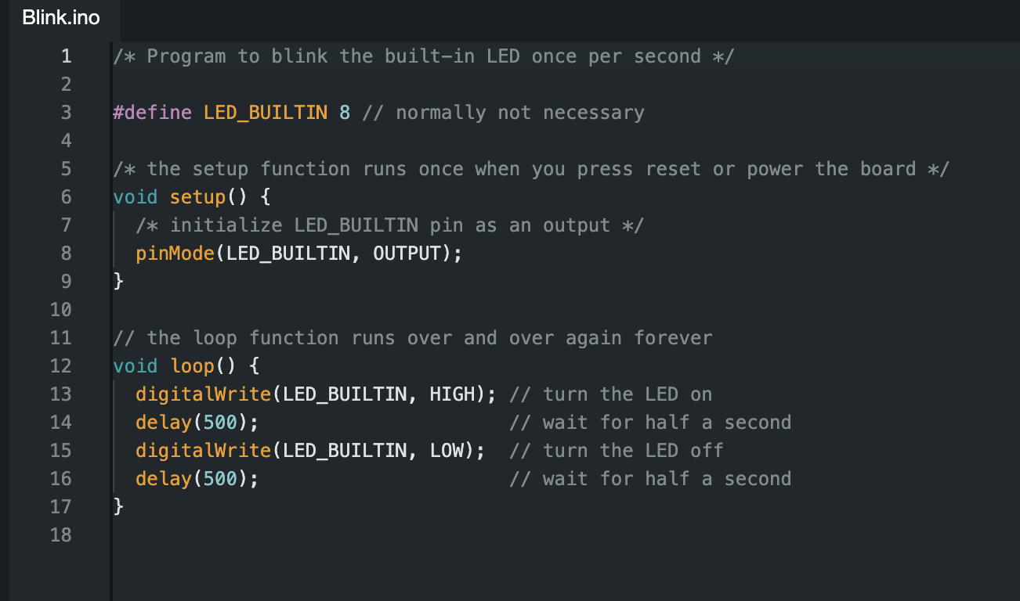
Blinky

Slide 17
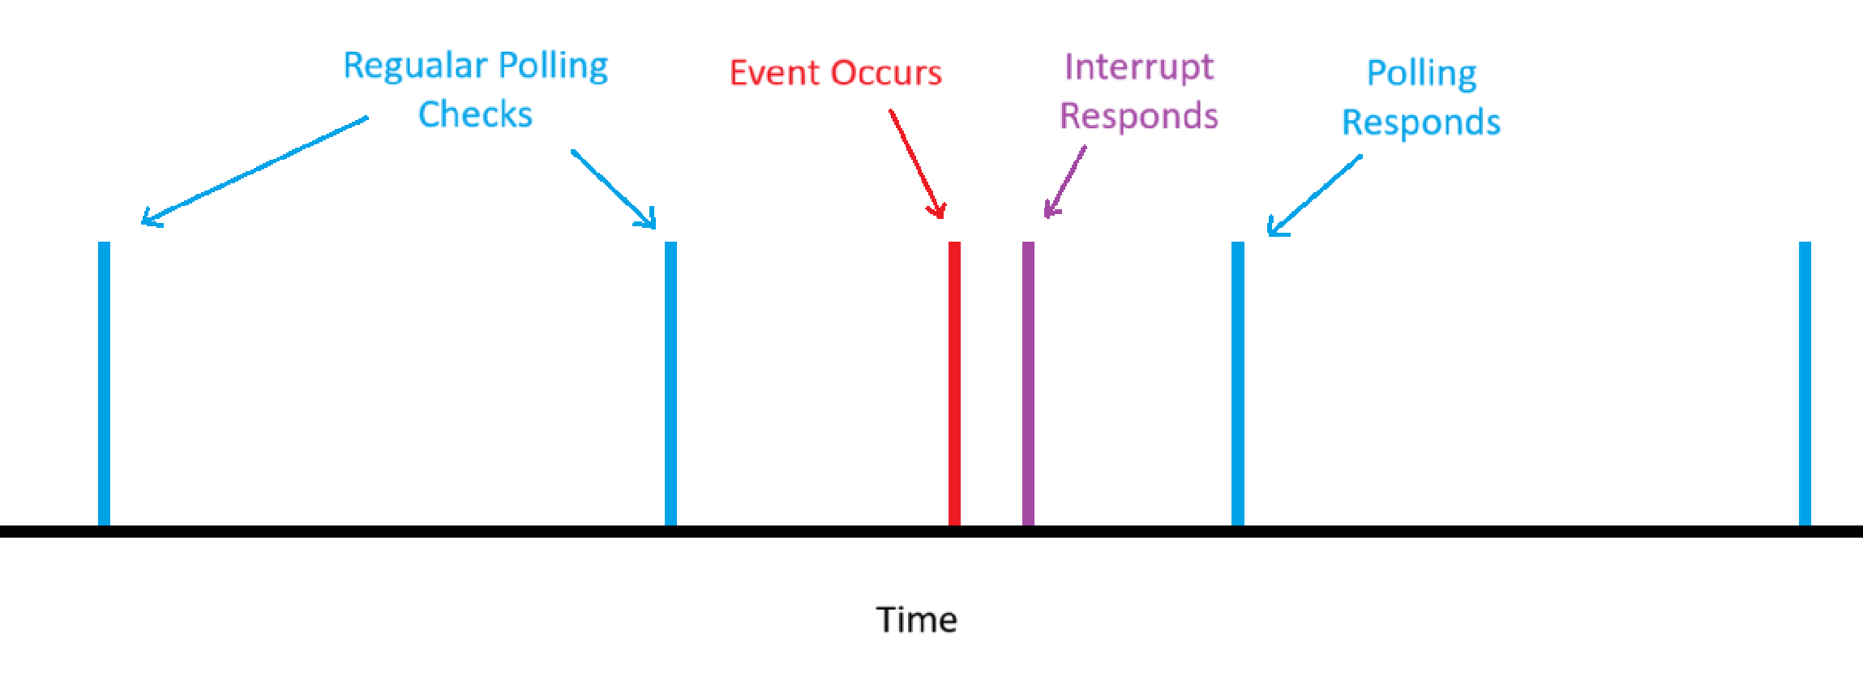
Polling vs Interrupts
Polling:
Wait and check a signal periodically
Easy to implement
Slow, lots of wasted CPU cycles
Interrupts
CPU stops what its doing to react to event
Harder to implement
Fast, no wasted CPU cycles

Slide 18
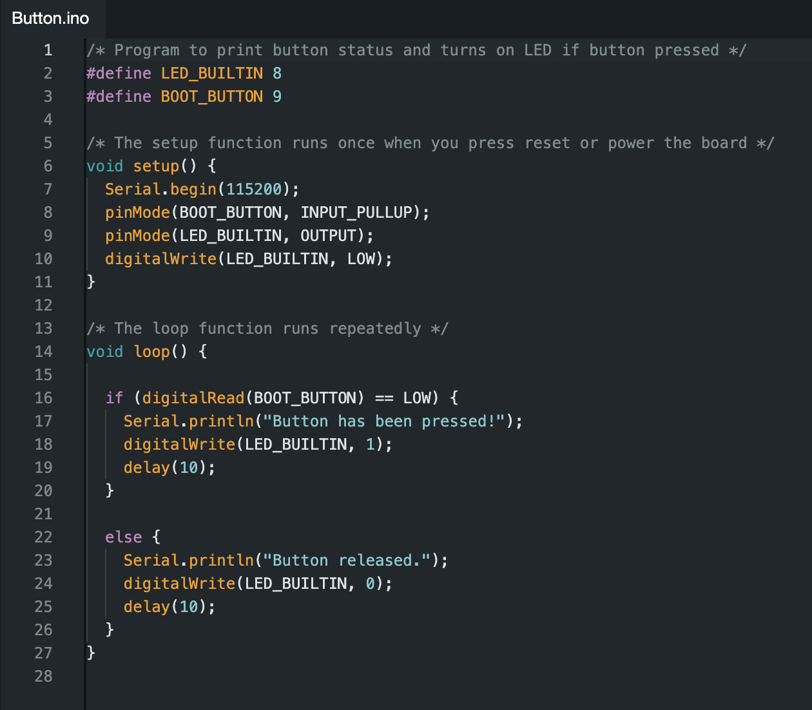
Digital IO

Slide 19

PWM Arduino

Slide 20
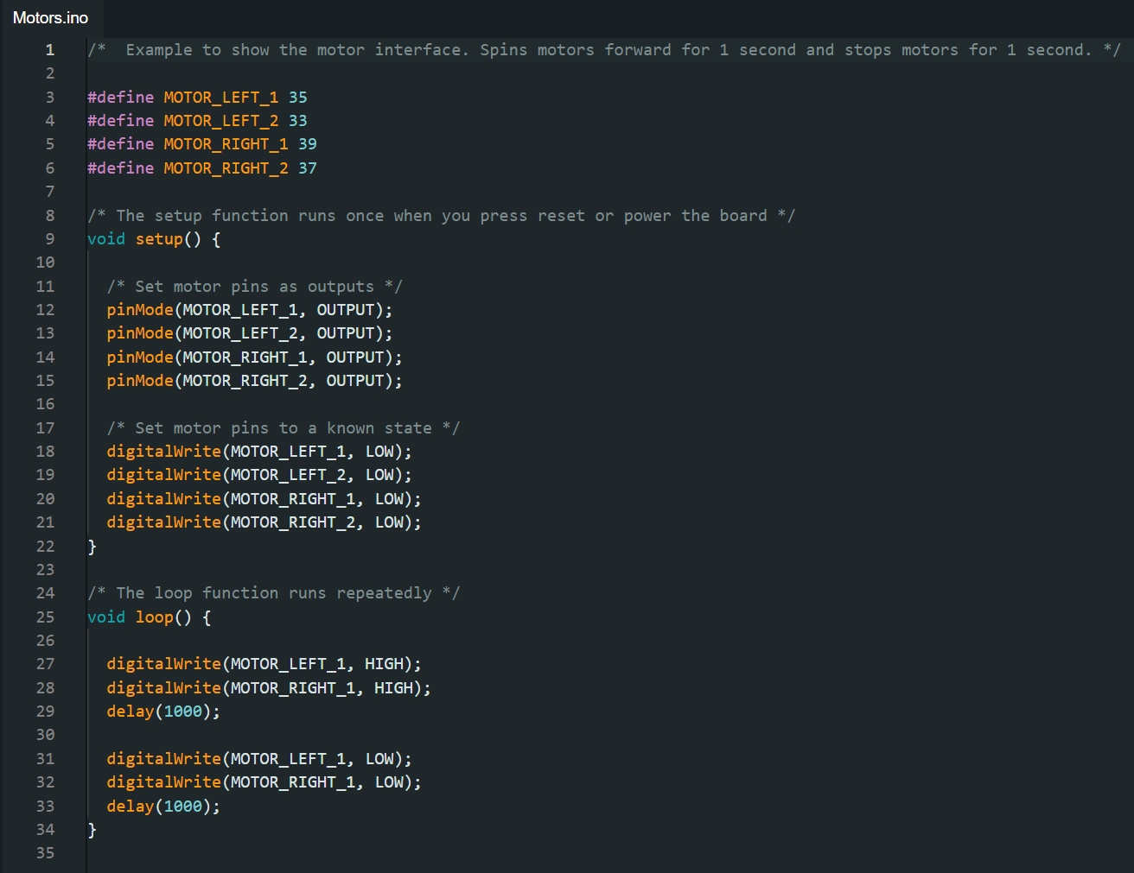
Analog GPIO

Slide 21
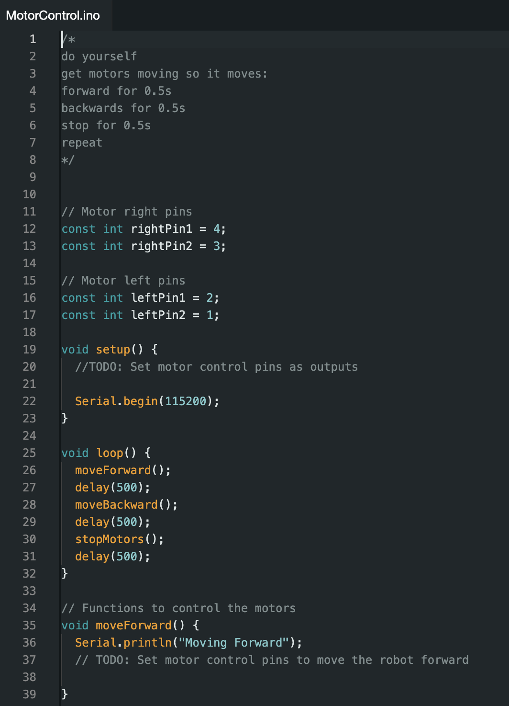
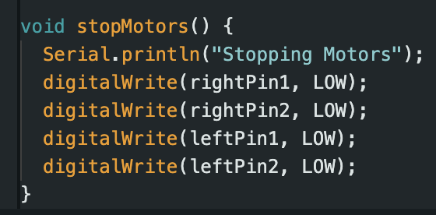
Motors
Motor pin | Microcontroller pin
rightPin1 | 4
rightPin2 | 3
leftPin1 | 2
leftPin2 | 1

Slide 22
Putting Everything Together

Slide 23
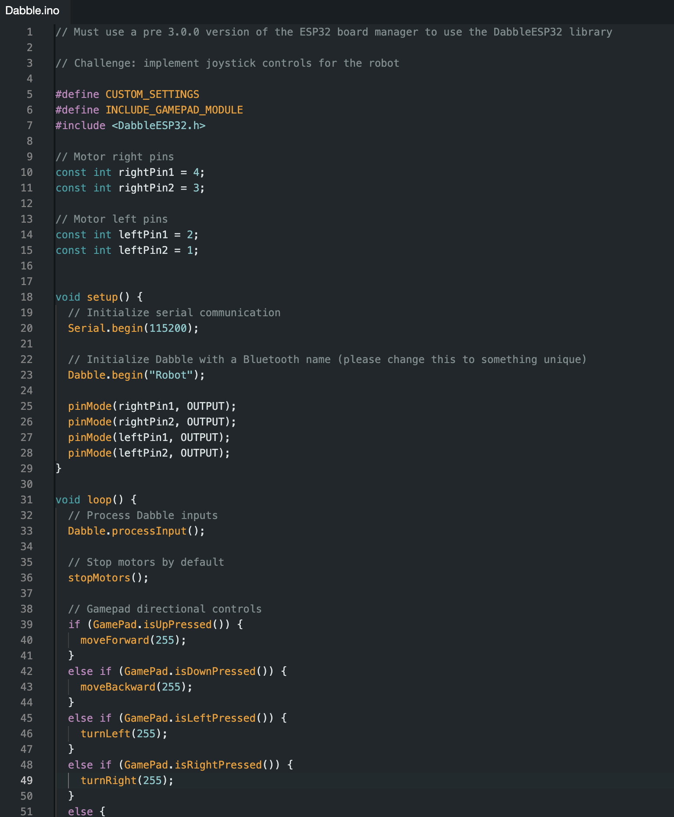
Dabble

Slide 24
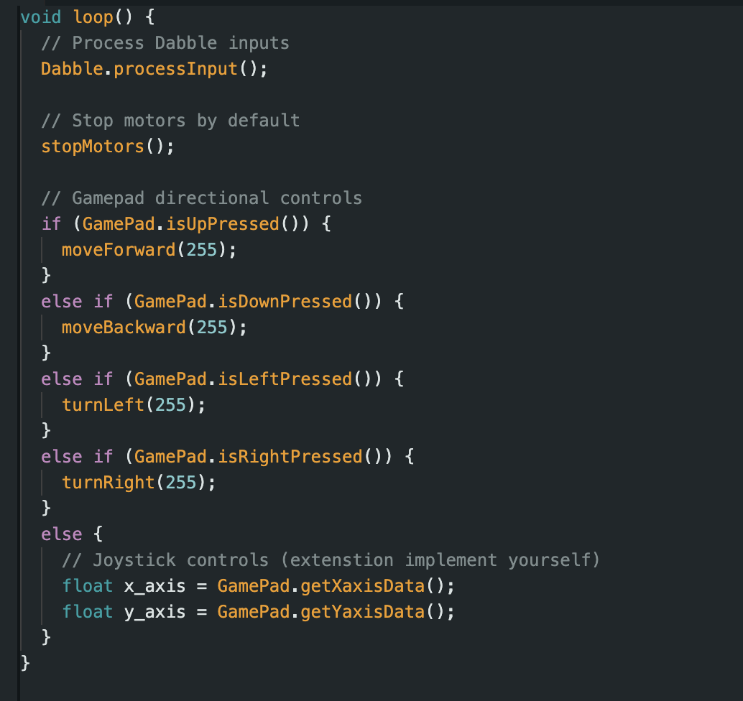
Dabble Challenge
Challenge
1. Make it work with the joystick
2. Use PWM to properly implement a joystick

Slide 25
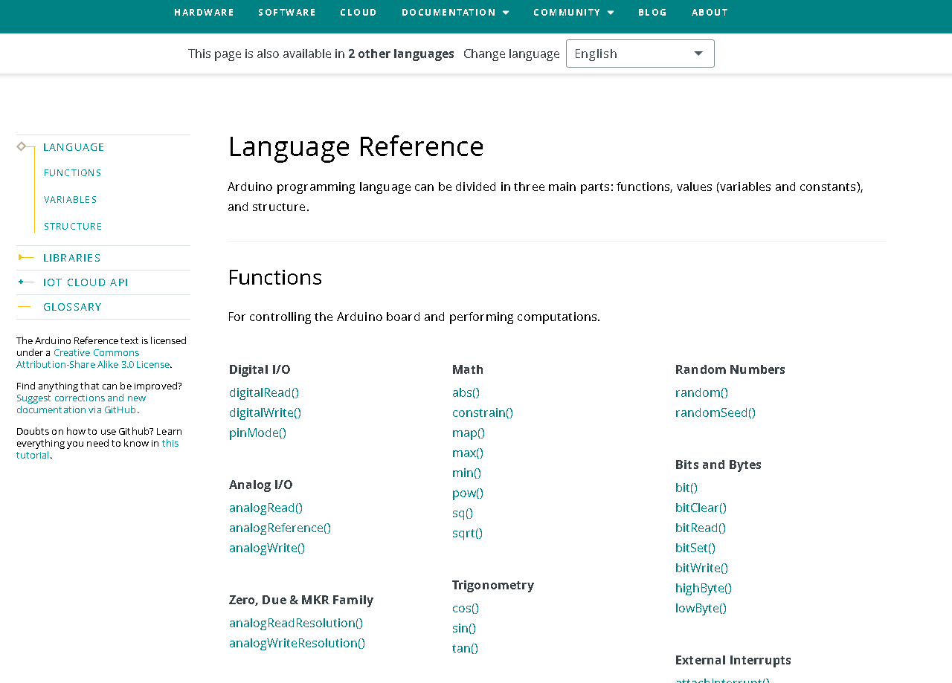
Arduino reference
https://www.arduino.cc/reference/en/

Slide 26

Code

